Slide 1
Panorama Heights (North Tustin) Petition to transfer from OUSD to TUSD
County Committee on School District Organization Meeting
May 17, 2016

Slide 2
Panorama Heights (North Tustin) School District Transfer Committee
Chief Petitioners:
Marlene Graham, Ed.D.
Jennifer Lampman
Catherine Mayberry
Goal - Unification of North Tustin Community:
Align social, emotional, and educational experiences with neighborhood activities
Following suit after another North Tustin area, Rocking Horse Ridge II’s successful petition approval to transfer territory from the OUSD to the TUSD in 2012. Another prior North Tustin ‘Orange Island’ territory transfer in 2002.
Freedom and the parental rights of the North Tustin community wanting to align our children to schools based on distinct community identity

Slide 3
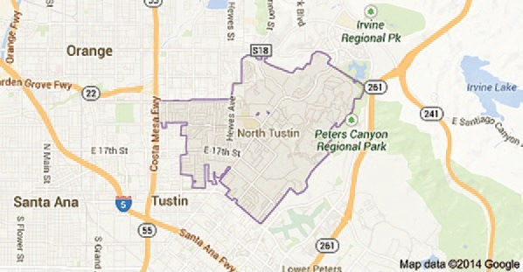
North Tustin Map
Support a Unified North Tustin Identity

Slide 4
North Tustin Community Profile
11,000 Homes in community, 25,000 Residents
4,600 acres unincorporated area, bordered by the city of Tustin on the west, south, and east, and by the city of Orange on the north. Government Services provided by Orange County Sheriff, Orange County Fire Authority (OCFA), East Orange County Water District (EOCWD) and County of Orange
U.S. Government census-designated place: the distinct unincorporated communities of Cowan Heights, East Tustin, Lemon Heights, North Tustin, Panorama Heights, and Red Hill. Mailing address and Google maps also identify neighborhood as North Tustin
Entire neighborhood is situated within the boundaries covered by the North Tustin Advisory Council and the Foothill Community Association, the local political advisory groups that protect the rights and interests of North Tustin residents

Slide 5
NORTH TUSTIN
Arroyo Elementary School
Unincorporated communities of Cowan Heights, East Tustin, Lemon Heights, North Tustin, Panorama Heights, and Red Hill
Foothill Community Association
Foothill High School
St. Paul's Episcopal Church and Preschool
Trinity United Presbyterian Church
Tustin Little Gym
North Tustin Political Action Committee
Newport Avenue
Tustin Tennis
Tustin AYSO
Grace Harbor Church
Tustin Girl Scouts
Tustin Boy Scouts
Wildfire Gymnastics
Hewes Middle School
Foothill Preschool
Tustin Pony League
North Tustin Community aligns with Tustin

Slide 6
Panorama Heights (North Tustin) Community Profile
Many children have tried or already attend TUSD schools as OUSD allows inter-district transfers to TUSD upon request. Note though that inter-district transfer permits are granted year-to-year on a space available basis only
Most Panorama Heights students who do utilize Panorama Elementary School, then go on to either Private Schools or transfer outside of OUSD
The primary sports, community, service, social, and faith organizations in which families of North Tustin participate and coach in are based in Tustin
Many children attend preschools in Tustin, that matriculate into Tustin Elementary Schools
The majority of residents support the Tustin community through sales tax by shopping primarily in Tustin stores
Educational & Social alignment – City of Tustin

Slide 7
OUSD Trustee area map
Rocking Horse Ridge II Petition Area
Panorama Heights Petition Area

Slide 8
Petition neighborhood
Petition and surrounding neighborhoods lie in closer proximity to TUSD schools than those in OUSD, and closer than several neighborhoods in TUSD boundary
Map below shows Panorama Heights,
Lower Panorama #1 and
Lower Panorama #2
Other Half of Panorama Heights in TUSD

Slide 9
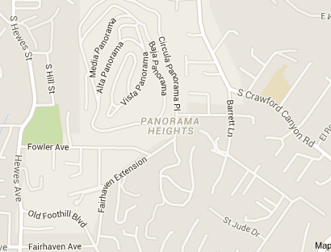
Petition neighborhood
Petition and surrounding neighborhoods primary, including single roads all lead through TUSD schools.
School district lines should be aligned with natural demarcation of North Tustin boundaries
Topography is a hill, clear boundary with City of Orange
Single road into Panorama Heights leads into TUSD
Other Half of Panorama Heights in TUSD

Slide 10
Petition timeline
Original petition was submitted in October 2015 including signatures from all of the other half of Panorama Heights, with overwhelming support from all neighbors
Second petition was submitted February, 2016, vetted and deemed sufficient by OC Department of Education
Adjacent neighborhoods of Lower Panorama #1 and Lower Panorama #2 were omitted from this petition, but are recommended to be considered to create a unified North Tustin
April 1, 2016: OUSD mailed out letters to parents of OUSD students regarding petition impact
RESULT = 0 Parents opposed to transfer responded
Goal – One school district for North Tustin

Slide 11
Petition COMPARISON
Rocking Horse Ridge II | Panorama Heights
43 Students in OUSD | 54 Students in OUSD
½ of Rocking Horse Ridge in TUSD | ½ of Panorama Heights in TUSD
North Tustin Community – zip code, social ties | North Tustin Community- zip code, social ties
“Fiscally, the loss of students will be marginal” – OUSD response | Fiscally, the loss of students will be marginal.
One Difference – Panorama Heights is closer to TUSD Schools

Slide 12
Criteria To Change School Districts Per Education Code
No. | Criteria | Petition Purpose
1 | The reorganized districts will meet the adequate enrollment condition | Panorama Heights represents less than 0.018% of OUSD enrollment
2 | The school districts are each organized on the basis of a substantial community identity | Panorama Heights residents identify with the North Tustin/Tustin community through sports, community groups, faith institutions, and commerce
3 | The transfer of territory will result in an equitable division of property and facilities of the original districts | The transfer of the small percentage of students that currently attend OUSD schools will not require any division of property and facilities within the district
4 | The transfer of territory will not promote racial or ethnic discrimination or segregation is substantially met | The current Panorama Heights students represent 0.018% of the OUSD current enrollment. Statistically, these numbers are insignificant, and will have no effect on demographic composition of either school district

Slide 13
Criteria To Change School Districts Per Education Code
No. | Criteria | Petition Purpose
5 | The transfer of territory will not result in any substantial increase in costs to the state | The unification of Panorama Heights into the rest of North Tustin community school boundaries will have no costs to the state
6 | The transfer of territory will not significantly disrupt the educational programs in the school districts and the school districts affected by the transfer of territory will continue sound educational performance is substantially met | The current Panorama Heights students represent 0.018% of the OUSD current enrollment. Statistically, these numbers are insignificant, and will have no effect on educational programs of either school district
7 | The transfer of territory will not result in a significant increase in school facilities costs | The transfer will require no new facilities costs
8 | The transfer of territory is not primarily designed to result in a significant increase in property values | The purpose of the transfer is to unify the North Tustin neighborhood, such that Panorama Heights children go to the same schools as their community of influence
9 | The transfer of territory will not negatively affect the fiscal management or fiscal status of either school district affected by the transfer of territory | The current Panorama Heights students represent 0.018% of the OUSD current enrollment. Statistically, these numbers are insignificant, and will have no effect on fiscal status of either school district

Slide 14
Purpose of petition
What the Petition is NOT about:
Isolate any part of our North Tustin community
Political or economic agenda
Unsubstantiated and unrelated cobbling of issues
OUSD is attempting to utilize their commissioned real estate appraisal for their bond marketing campaign for use on this petition.
The appraisal has a stated purpose to ascertain property values with stated limitations: “it may not be used for other than its intended use”
What the Petition IS about:
Freedom and the parental rights of the North Tustin community wanting to organize our schools based on community identity
Unite the other half of Panorama Heights to the rest of Panorama Heights and with North Tustin as a whole
Unification of North Tustin community

Slide 15
Conclusion
The arbitrary OUSD and TUSD school districts boundary lines are causing a divide of the 2 halves of Panorama Heights in North Tustin
Families in the Panorama Heights neighborhood, including Lower Panorama #1and #2, identify with and are considered North Tustin by the Postal Service, OCFA, NTAC, OC Sheriff’s and all other service providers
Petition would align residents of Panorama Heights with their community of influence and keep students with their peers, provide stability without reliance on space availability, and allow students to attend schools geographically closer than those in OUSD
Substantially meet criteria for transfer

